Slide 1
Dataset 1
Mod 1
R1MC1
R1MC2
R1MC3
R1MC4
R1MC5
Dataset 2
Mod 2
R2MC1
R2MC2
R2MC3
R2MC4
R2MC5
Dataset 3
Mod 3
R3MC1
R3MC2
R3MC3
R3MC4
R3MC5
Dataset 4
Dataset 5
Mod 4
R4MC1
R4MC2
R4MC3
R4MC4
R4MC5
Mod 5
R5MC1
R5MC2
R5MC3
R5MC4
R5MC5

Slide 2
R1MC1
R1MC2
R1MC3
R1MC4
R1MC5
R1MCProm
4500
R2MC1
R2MC2
R2MC3
R2MC4
R2MC5
R2MCProm
4540
R3MC1
R3MC2
R3MC3
R3MC4
R3MC5
R3MCProm
4654
R4MC1
R4MC2
R4MC3
R4MC4
R4MC5
R4MCProm
5000
R5MC1
R5MC2
R5MC3
R5MC4
R5MC5
R5MCProm
4800

Slide 3
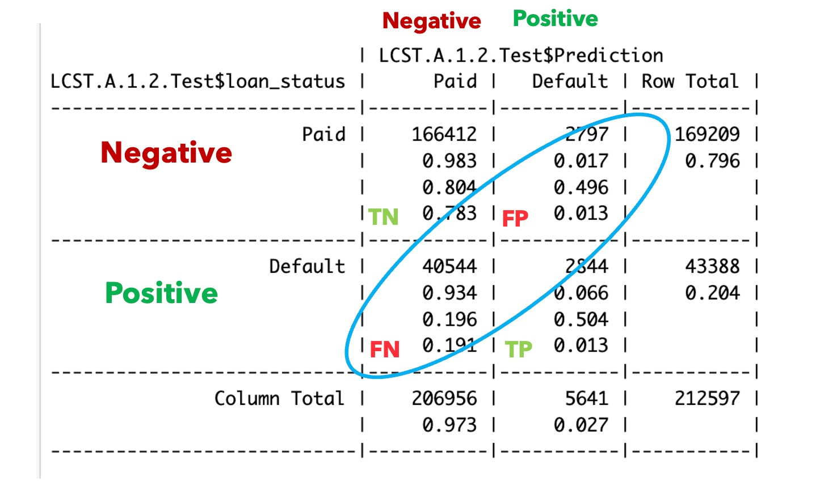

Slide 4
